Slide 1
Matplotlib for Data Science
Beginner guide to the most useful plotting functions
Create graphs from Python data.
Choose the right plot for the question.
Add titles, labels, legends, grids, and reference lines.
Create multiple plots and save figures.

Slide 2
1. Import Matplotlib
Most beginner plots use matplotlib.pyplot.
The standard abbreviation is plt.
Run this import once before trying the later examples.
# Import once at the start of your notebook.
import matplotlib.pyplot as plt

Slide 3
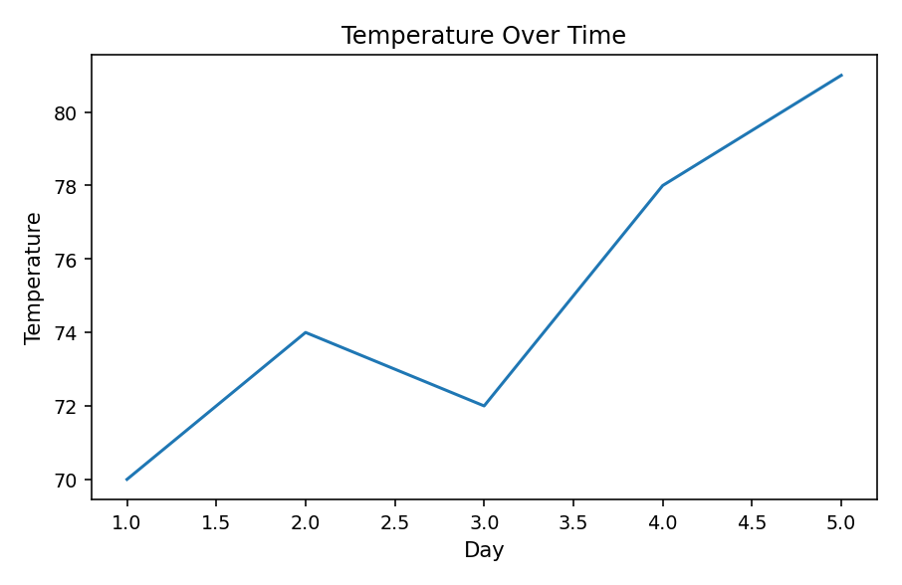
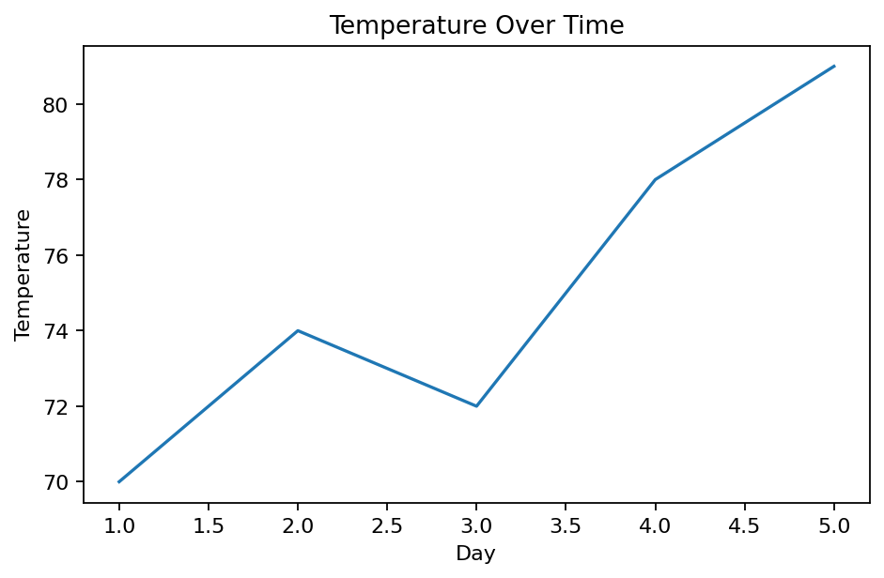
2. Line Plot — plt.plot()
Use a line plot for values across an ordered sequence.
Common x-values: days, months, or years.
The x-values go first; y-values go second.
days = [1, 2, 3, 4, 5]
temps = [70, 74, 72, 78, 81]
plt.plot(days, temps)
plt.xlabel("Day")
plt.ylabel("Temperature")
plt.title("Temperature Over Time")
plt.show()

Slide 4
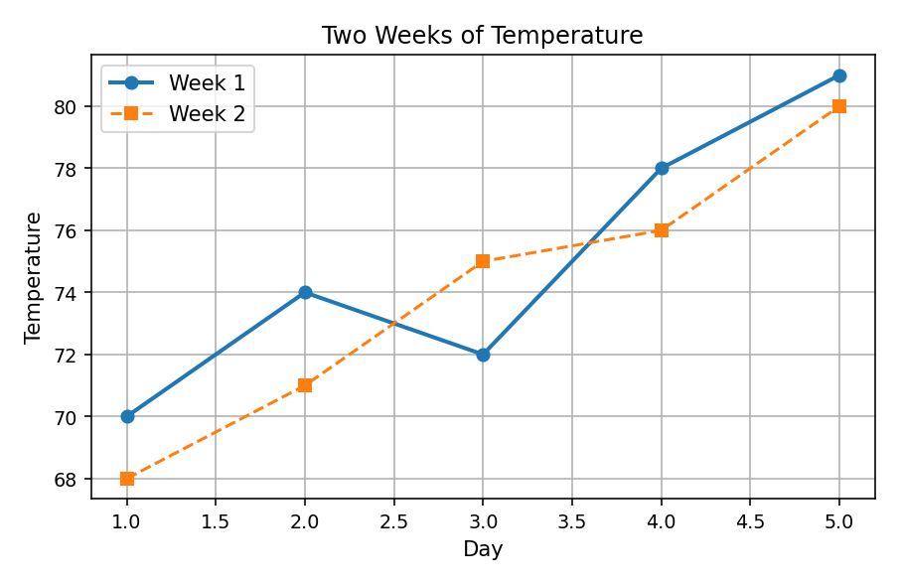
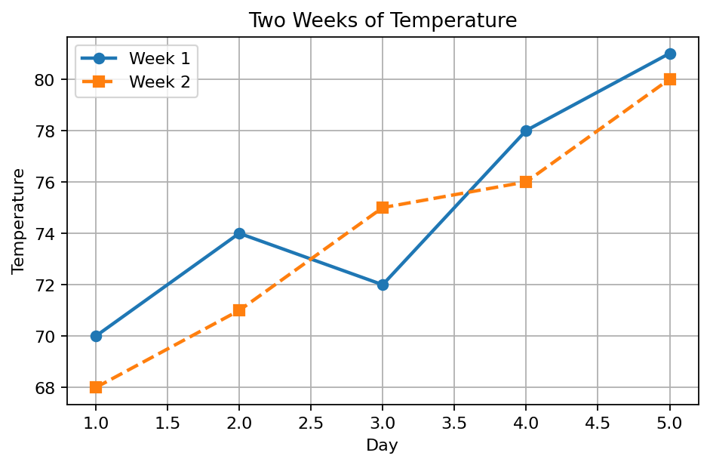
3. Line Plot Extras
marker= shows each observation.
linestyle= changes solid or dashed lines.
linewidth= sets line thickness.
label= names each series in the legend.
grid() and legend() aid comparison.
days = [1, 2, 3, 4, 5]
week_1 = [70, 74, 72, 78, 81]
week_2 = [68, 71, 75, 76, 80]
plt.plot(days, week_1, marker="o",
linewidth=2, label="Week 1")
plt.plot(days, week_2, marker="s",
linestyle="--", label="Week 2")
plt.xlabel("Day")
plt.ylabel("Temperature")
plt.title("Two Weeks of Temperature")
plt.grid(True)
plt.legend()
plt.show()

Slide 5
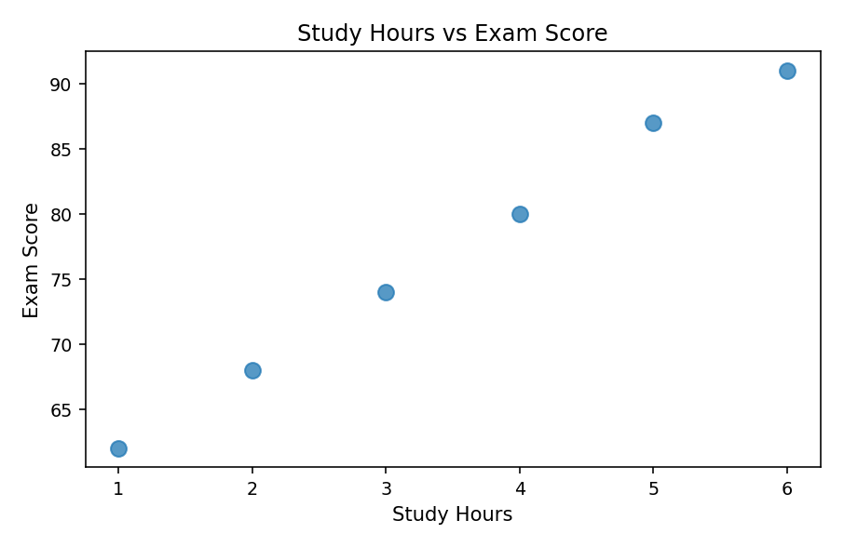
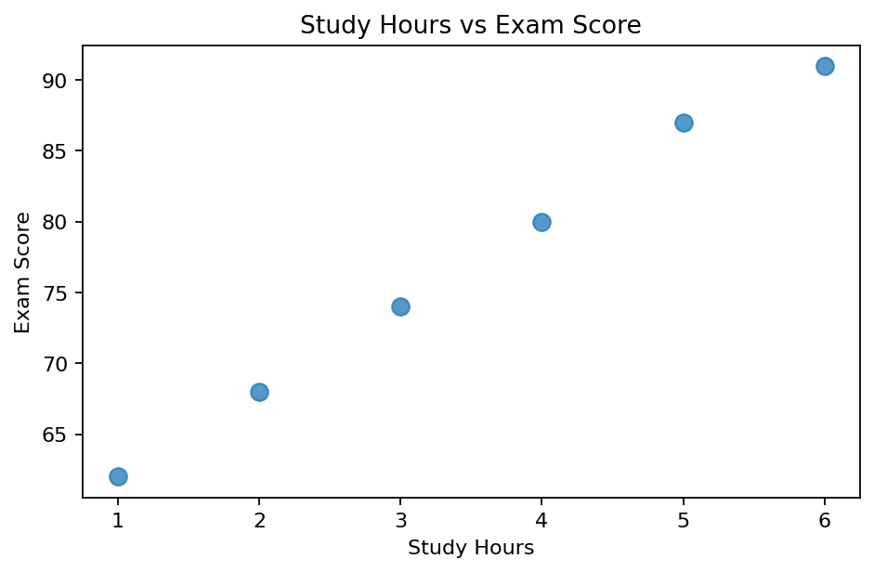
4. Scatter Plot — plt.scatter()
Use a scatter plot for two numerical variables.
Each dot represents a paired observation.
Here: study hours versus exam score.
s= sets marker area; alpha= sets opacity (0–1).
study_hours = [1, 2, 3, 4, 5, 6]
exam_scores = [62, 68, 74, 80, 87, 91]
plt.scatter(study_hours, exam_scores,
s=70, alpha=0.75)
plt.xlabel("Study Hours")
plt.ylabel("Exam Score")
plt.title("Study Hours vs Exam Score")
plt.show()

Slide 6
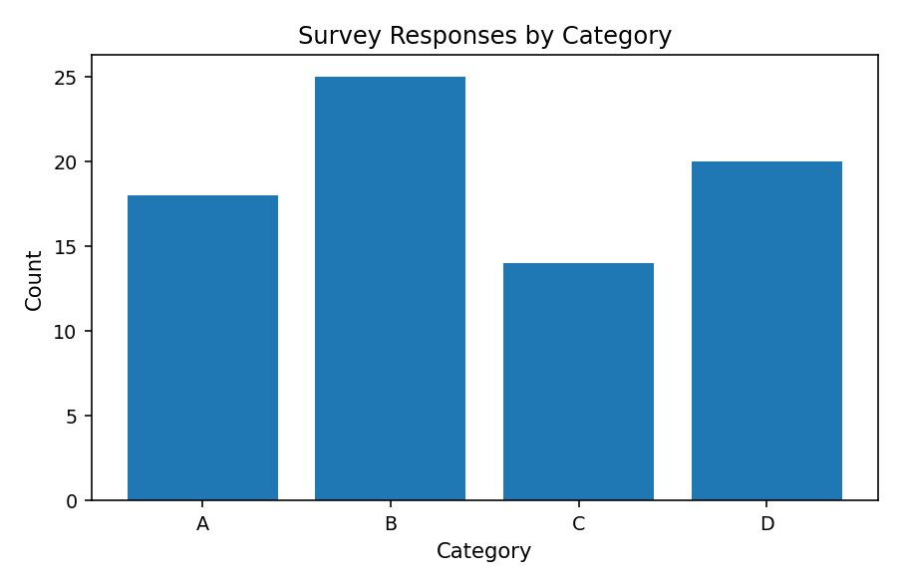
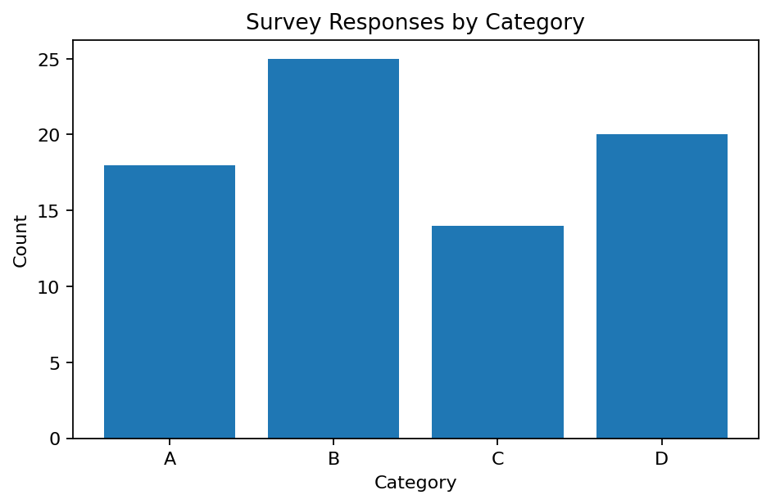
5. Bar Plot — plt.bar()
Use bar charts to compare categories.
Categories appear along the x-axis.
The numerical values determine bar height.
Unlike a histogram, the bars represent groups.
categories = ["A", "B", "C", "D"]
counts = [18, 25, 14, 20]
plt.bar(categories, counts)
plt.xlabel("Category")
plt.ylabel("Count")
plt.title("Survey Responses by Category")
plt.show()

Slide 7
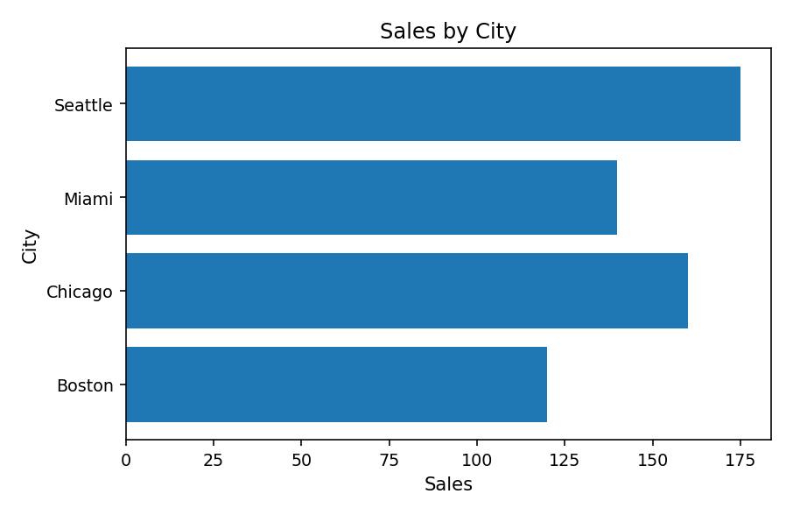
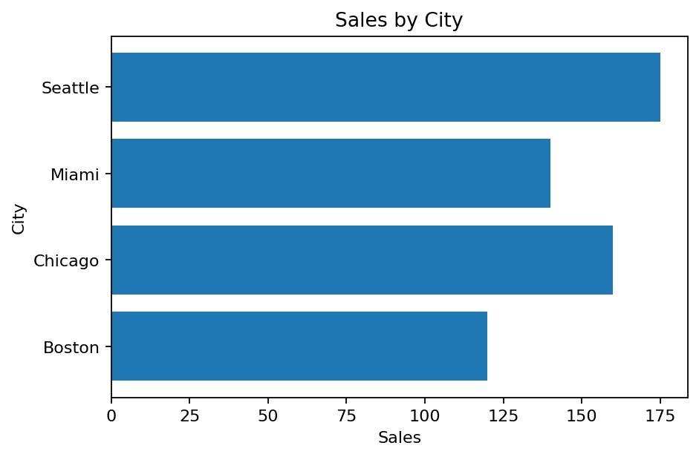
6. Horizontal Bar — plt.barh()
A horizontal bar chart compares categories.
Here, category names are along the y-axis.
Useful for longer names or many categories.
cities = ["Boston", "Chicago", "Miami", "Seattle"]
sales = [120, 160, 140, 175]
plt.barh(cities, sales)
plt.xlabel("Sales")
plt.ylabel("City")
plt.title("Sales by City")
plt.show()

Slide 8
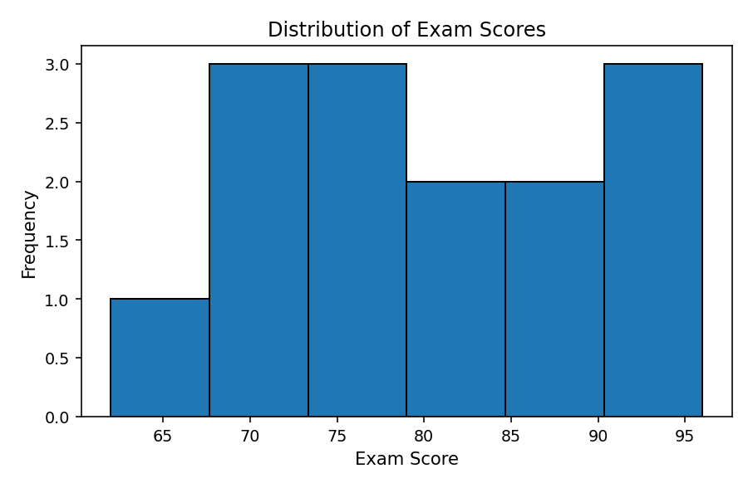
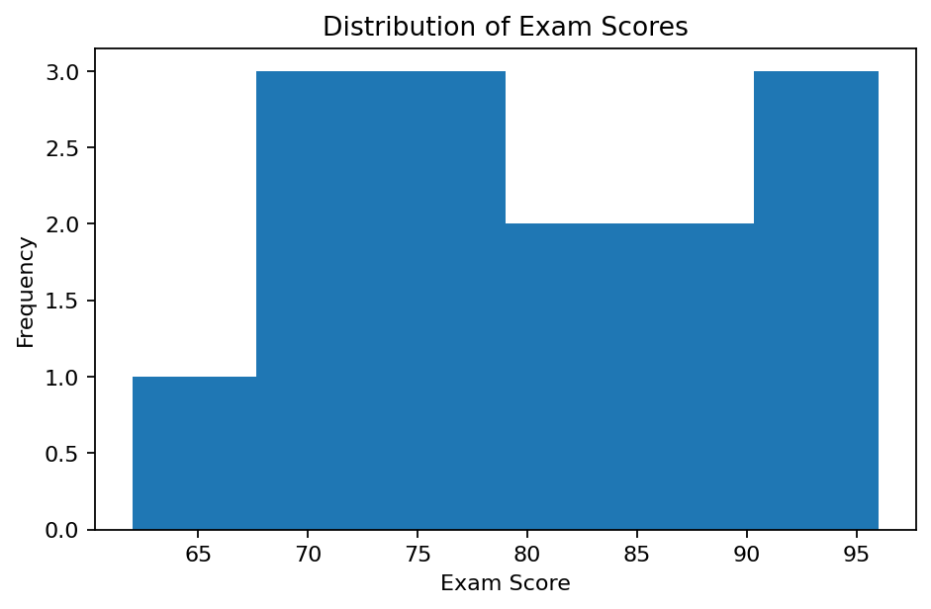
7. Histogram — plt.hist()
A histogram shows one numerical distribution.
Bins group values into numerical intervals.
Bar height shows frequency in each interval.
bins=6 creates six intervals; edges show them.
scores = [62, 68, 70, 71, 74, 76, 78,
80, 82, 85, 88, 91, 94, 96]
plt.hist(scores, bins=6, edgecolor="black")
plt.xlabel("Exam Score")
plt.ylabel("Frequency")
plt.title("Distribution of Exam Scores")
plt.show()

Slide 9
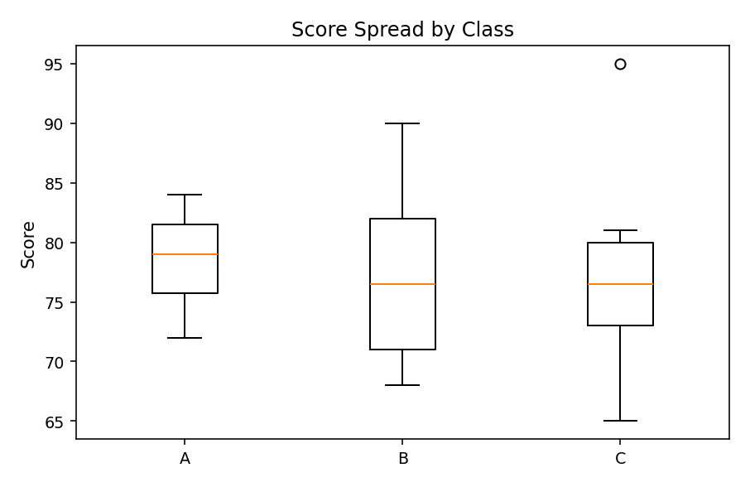
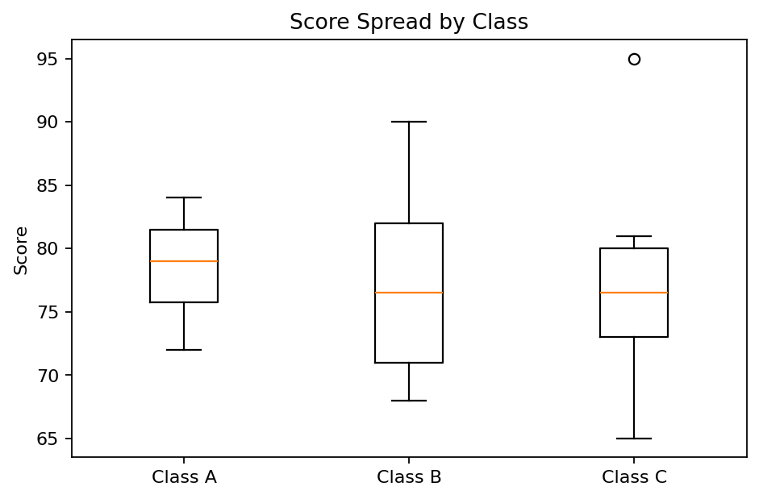
8. Box Plot — plt.boxplot()
A box plot summarizes the distribution of scores.
The line in each box marks the median.
The box spans Q1 to Q3; whiskers show non-outlier range.
Points beyond whiskers may be outliers.
class_scores = [
[72, 75, 78, 80, 82, 84],
[68, 70, 74, 79, 83, 90],
[65, 72, 76, 77, 81, 95]
]
plt.boxplot(class_scores,
tick_labels=["A", "B", "C"])
plt.ylabel("Score")
plt.title("Score Spread by Class")
plt.show()

Slide 10
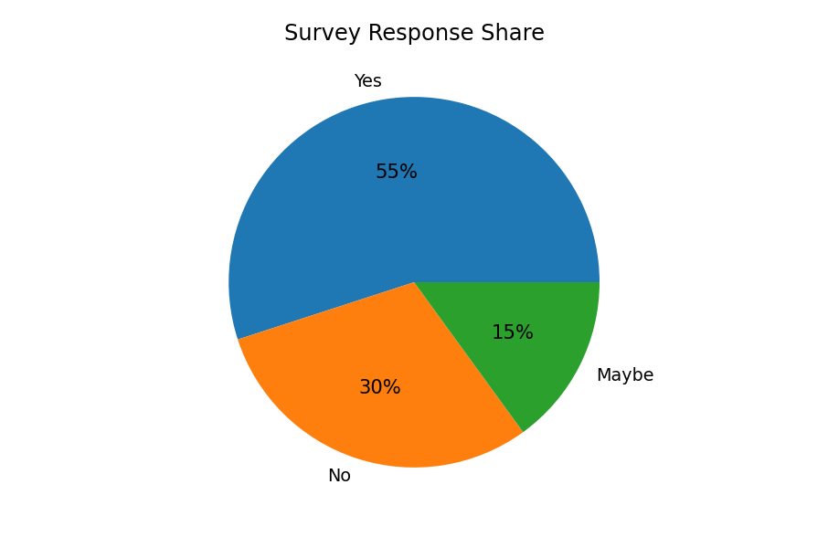
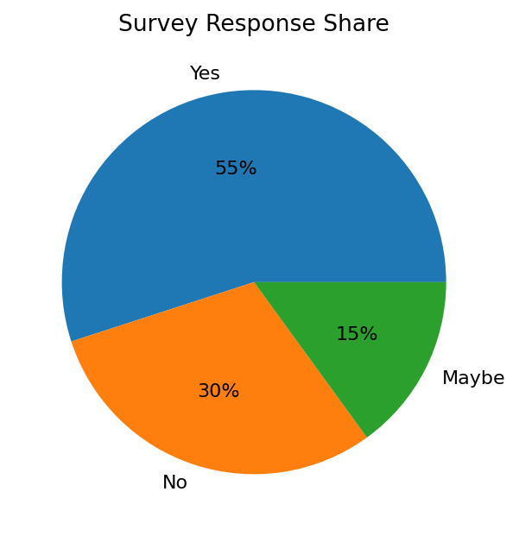
9. Pie Chart — plt.pie() (Optional)
Shows categories as parts of a whole.
Best when there are only a few categories.
Bar charts often make comparisons easier.
autopct= displays percentages on slices.
labels = ["Yes", "No", "Maybe"]
values = [55, 30, 15]
plt.pie(values, labels=labels,
autopct="%1.0f%%")
plt.title("Survey Response Share")
plt.show()

Slide 11
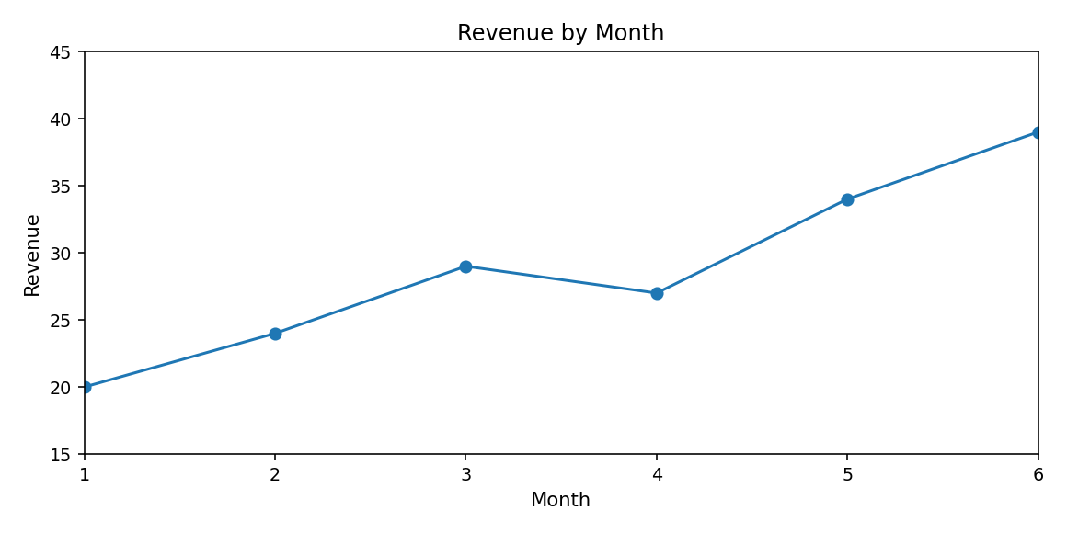
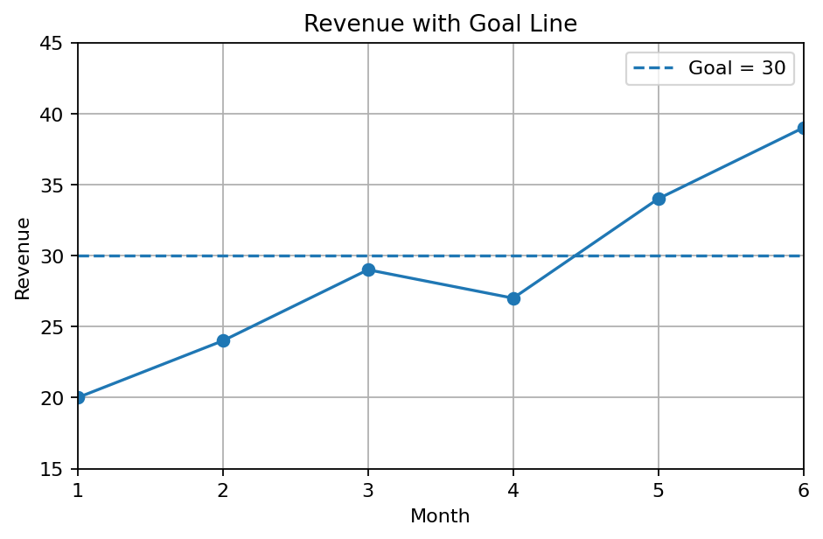
10. Figure Size + Axis Controls
figure(figsize=(8, 4)) sets width and height (inches).
xlim() and ylim() set the visible axis ranges.
These commands do not change the underlying data.
Be careful: a narrow range can distort comparisons.
months = [1, 2, 3, 4, 5, 6]
revenue = [20, 24, 29, 27, 34, 39]
plt.figure(figsize=(8, 4))
plt.plot(months, revenue, marker="o")
plt.xlim(1, 6)
plt.ylim(15, 45)
plt.xlabel("Month")
plt.ylabel("Revenue")
plt.title("Revenue by Month")
plt.show()

Slide 12
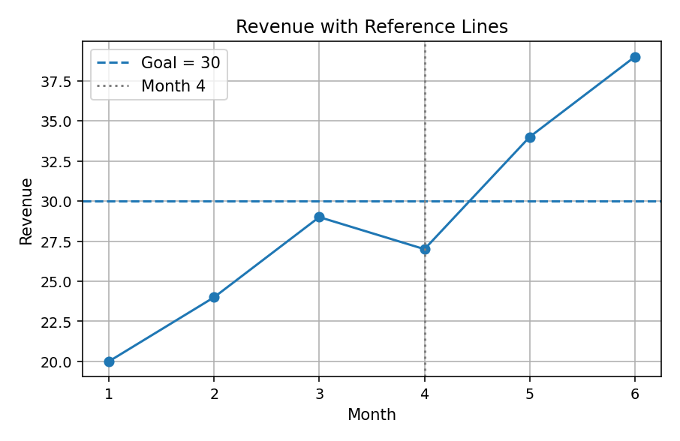
11. Reference Lines
axhline(y=...) adds a horizontal threshold.
axvline(x=...) marks a specific x-value.
Use them for goals, averages, events, or cutoffs.
Neither changes the underlying data.
months = [1, 2, 3, 4, 5, 6]
revenue = [20, 24, 29, 27, 34, 39]
plt.plot(months, revenue, marker="o")
plt.axhline(y=30, linestyle="--",
label="Goal = 30")
plt.axvline(x=4, color="gray", linestyle=":",
label="Month 4")
plt.xlabel("Month")
plt.ylabel("Revenue")
plt.title("Revenue with Reference Lines")
plt.legend()
plt.grid(True)
plt.show()

Slide 13
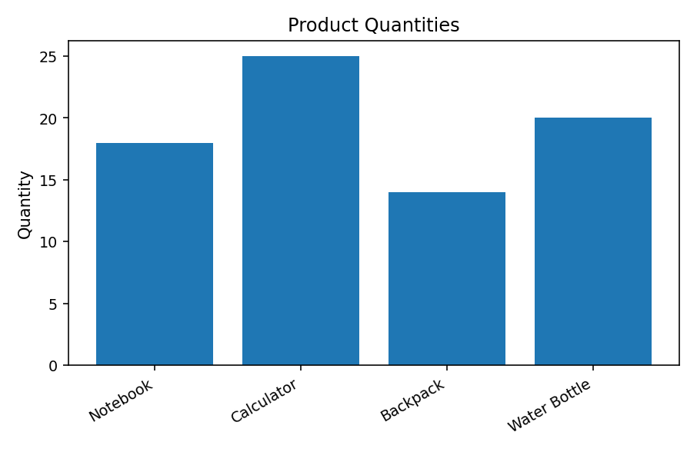
12. Tick Labels — plt.xticks()
xticks() controls x-axis tick labels.
rotation= helps labels fit without overlapping.
ha='right' aligns rotated text more neatly.
yticks() provides similar y-axis controls.
products = ["Notebook", "Calculator",
"Backpack", "Water Bottle"]
quantities = [18, 25, 14, 20]
plt.bar(products, quantities)
plt.xticks(rotation=30, ha="right")
plt.ylabel("Quantity")
plt.title("Product Quantities")
plt.tight_layout()
plt.show()

Slide 14
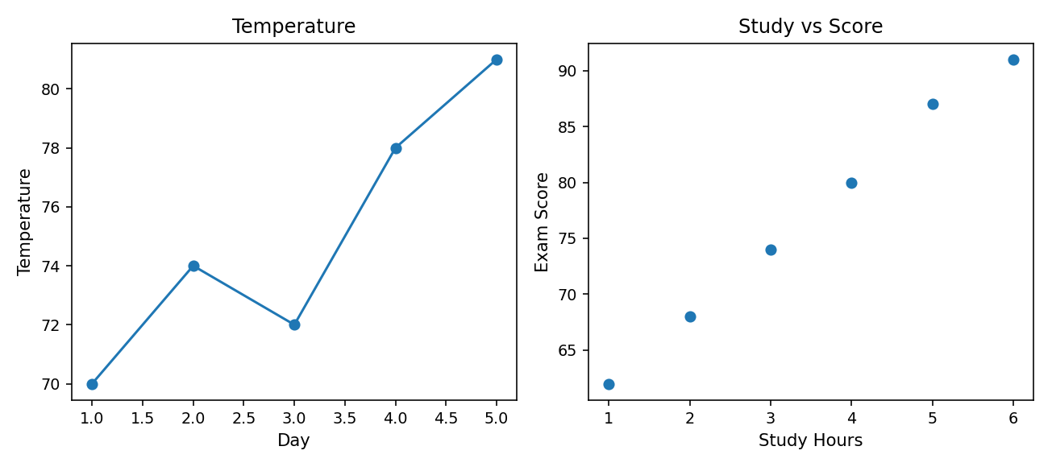
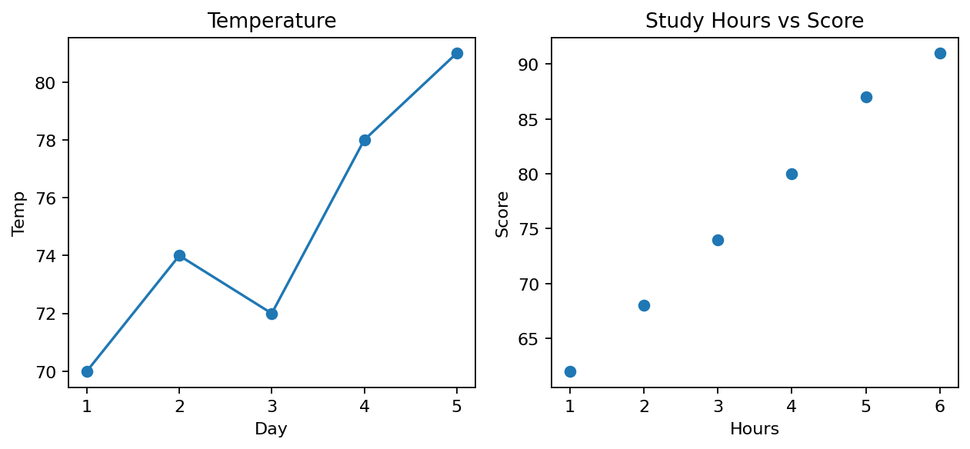
13. Multiple Plots — plt.subplots()
subplots() creates multiple plots in one figure.
fig is the whole figure; axes stores each subplot.
axes[0] and axes[1] select the two areas.
Use set_xlabel(), set_ylabel(), and set_title().
tight_layout() helps avoid overlapping elements.
days = [1, 2, 3, 4, 5]
temps = [70, 74, 72, 78, 81]
study_hours = [1, 2, 3, 4, 5, 6]
exam_scores = [62, 68, 74, 80, 87, 91]
fig, axes = plt.subplots(1, 2, figsize=(9, 4))
axes[0].plot(days, temps, marker="o")
axes[0].set_title("Temperature")
axes[0].set_xlabel("Day")
axes[0].set_ylabel("Temperature")
axes[1].scatter(study_hours, exam_scores)
axes[1].set_title("Study vs Score")
axes[1].set_xlabel("Study Hours")
axes[1].set_ylabel("Exam Score")
fig.tight_layout()
plt.show()

Slide 15
14. Save a Figure — plt.savefig()
savefig() writes the figure to a file.
Examples: PNG, JPG, PDF, SVG.
dpi= sets raster-image resolution.
Save before show(); no folder means current directory.
days = [1, 2, 3, 4, 5]
temps = [70, 74, 72, 78, 81]
plt.plot(days, temps)
plt.xlabel("Day")
plt.ylabel("Temperature")
plt.title("Temperature Over Time")
plt.savefig("temperature_plot.png", dpi=150)
plt.show()

Slide 16
15. Choosing the Right Plot
Change over time → Line plot
Two numerical variables → Scatter plot
Compare categories → Bar plot
One numerical distribution → Histogram
Compare distributions → Box plot
Small part-to-whole display → Pie chart
# Ask first:
# "What question am I trying
# to answer with this graph?"

Slide 17
16. Matplotlib Cheat Sheet
Plot types: plot, scatter, bar, barh, hist, boxplot, pie.
Labels: xlabel, ylabel, title.
Extras: legend, grid, figure, xlim, ylim, xticks.
Advanced beginner: subplots, tight_layout, savefig.
These are patterns, not a single runnable program.
# Quick reference: replace names with your data.
# plt.plot(x_values, y_values)
# plt.scatter(x_values, y_values)
# plt.bar(categories, counts)
# plt.barh(categories, counts)
# plt.hist(numbers, bins=6)
# plt.boxplot(groups)
# plt.xlabel("X label")
# plt.ylabel("Y label")
# plt.title("Graph title")
# plt.legend() # For labeled plots
# plt.grid(True)
# plt.show()

Slide 18
17. Final Practice
Use weekday visitor data.
Create a line plot.
Add markers, labels, a title, and a grid.
Add a horizontal reference line at 150.
Explain why a line plot is appropriate.
days = ["Mon", "Tue", "Wed", "Thu", "Fri"]
visitors = [120, 150, 135, 180, 210]
# Your turn: build the graph here.

Slide 19
18. Official Matplotlib Resources
Pyplot summary
Plot type gallery
Subplots documentation
Use the official docs when you forget an argument or function.
https://matplotlib.org/stable/
api/pyplot_summary.html
https://matplotlib.org/stable/
plot_types/index.html
https://matplotlib.org/stable/
api/_as_gen/
matplotlib.pyplot.subplots.html

